Slide 1
Electronic Devices and Circuits
Dr. Junaid Ahmed

Slide 2
Contents
Semiconductor diode
Crystal diode as rectifier
Resistance of crystal diode
Equivalent circuit of crystal diode
Important terms related to diode
Forward current
Peak inverse voltage
Leakage current
Half-wave rectifier
Output frequency of Half-wave rectifier
Efficiency of Half-wave rectifier

Slide 3
Semiconductor diode:
“A pn junction is known as a semi-conductor or crystal diode.”
Having two terminals (anode and cathode)
Can be connected in forward and reverse biased
Allow current to flow only in one direction
Use as a rectifier (a.c to d.c conversion)

Slide 4
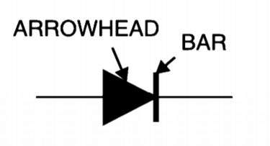
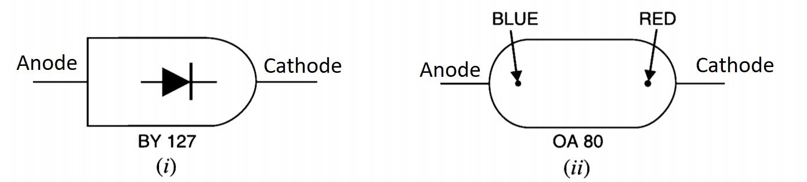
Semiconductor diode: (cont.)
Schematic symbol of diode:
Identification of crystal diode terminals:

Slide 5
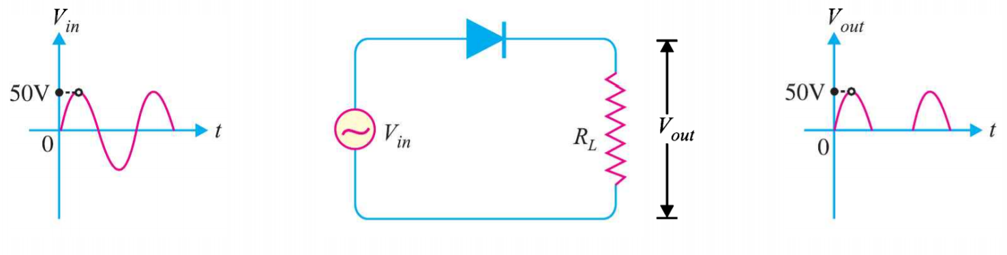
Crystal diode as rectifier:
“Crystal diode is used as a rectifier to convert a.c signal into d.c signal. The diode conducts only for the positive half cycle cycle where for negative half cycle, it do not conduct, in this way crystal diode converts a.c signal into d.c”
Also behave as a switch:
when diode is forward biased, it behaves as a closed switch and connects the a.c supply to the load.
When diode is reverse biased, it behaves as an open switch and disconnect the a.c supply from the load

Slide 6
Resistance of crystal diode:
As, we know that forward biased diode conducts easily whereas a reverse biased diode practically conduct no current.
The reason is that, forward resistance of diode is quite small as compared to the reverse resistance.

Slide 7
Resistance of crystal diode: (cont.)
Forward Resistance:
Under the forward biased condition, the opposition offered by a diode to the forward current is known as Forward Resistance.
Therefore, this resistance is of two types:
  d.c./static forward resistance
  a.c./dynamic forward resistance
The forward resistance of diode is very small, ranging from 1 to 25Ω.

Slide 8
Resistance of crystal diode: (cont.)
d.c. forward resistance:
The opposition offered by a diode to the direct current flowing in forward bias condition is known as its d.c. forward resistance or static resistance.
It is measured by taking the ratio of d.c. voltage across the diode to the d.c. current flowing through it.

Slide 9
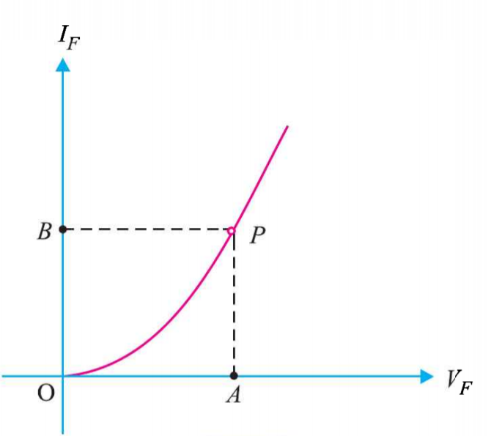
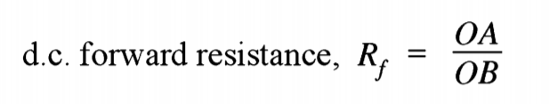
Resistance of crystal diode: (cont.)
d.c. forward resistance: (cont.)
It is clear from the figure given below that when forward voltage is OA, the forward current is OB, the d.c. forward resistance is:

Slide 10
Resistance of crystal diode: (cont.)
a.c. forward resistance:
The opposition offered by a diode to the changing current flowing in forward bias condition is known as its a.c. forward resistance.
It is measured by a ratio of change in voltage across the diode to the resulting change in current through it given as:

Slide 11
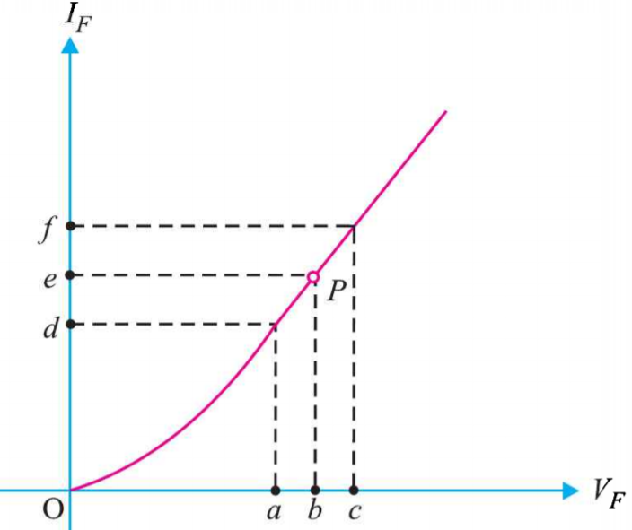
Resistance of crystal diode: (cont.)
a.c. forward resistance: (cont.)
The a.c. forward resistance is more significant as the diodes are generally used alternating voltages.
With respect to the graph given in figure given below, the a.c. forward resistance is given as:

Slide 12
Resistance of crystal diode: (cont.)
a.c. forward resistance: (cont.)
The forward resistance of diode is very small ranging from 1 to 25 ohm.

Slide 13
Resistance of crystal diode: (cont.)
Reverse Resistance:
Under the reverse biased condition, the opposition offered by the diode to the reverse current is known as reverse resistance.
It can be d.c. reverse resistance or a.c. reverse resistance.
Ideally, the reverse resistance of a diode is infinite.
Practically the reverse resistance is not infinite, because for any value of reverse bias, there exist a small leakage current.
The reverse resistance is very high as compared to forward resistance.

Slide 14
Equivalent circuit of crystal diode:
The electrical equivalent circuit of crystal diode is a combination of electric elements.
The equivalent circuit of device (crystal diode) acts similarly as the device when connected in circuit.
The resulting network can be solved by traditional circuit analysis techniques.

Slide 15

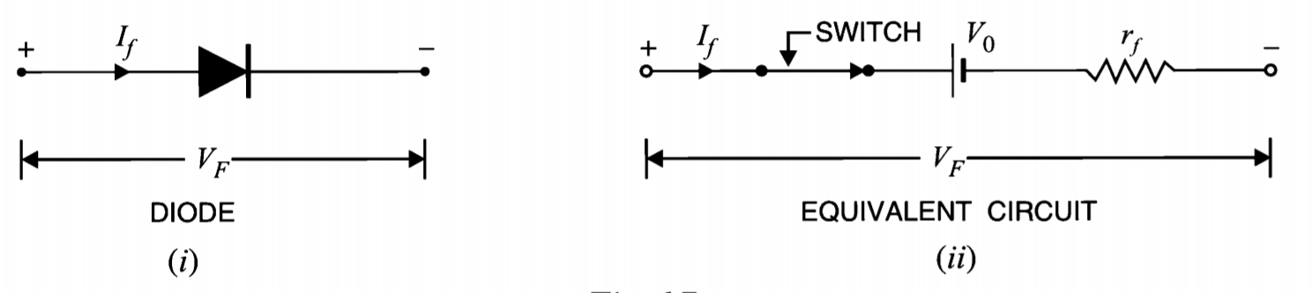
Equivalent circuit of crystal diode: (cont.)
Approximate equivalent circuit:

Slide 16
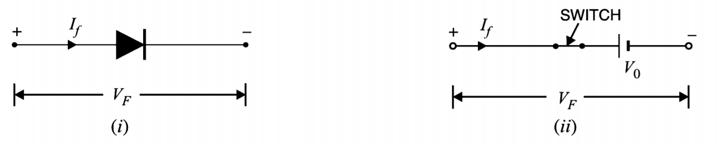
Equivalent circuit of crystal diode: (cont.)
Simplified equivalent circuit:
In most applications, the internal resistance of the crystal diode can be ignored in comparison to other elements in the equivalent circuit.

Slide 17
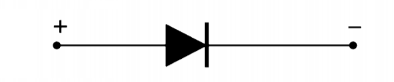
Equivalent circuit of crystal diode: (cont.)
Ideal diode model:
Ideally, the internal resistance and potential barrier is considered negligible.
Act as a perfect conductor in forward biased and as perfect insulator when reverse biased.
Ideal diode never found in practice.

Slide 18
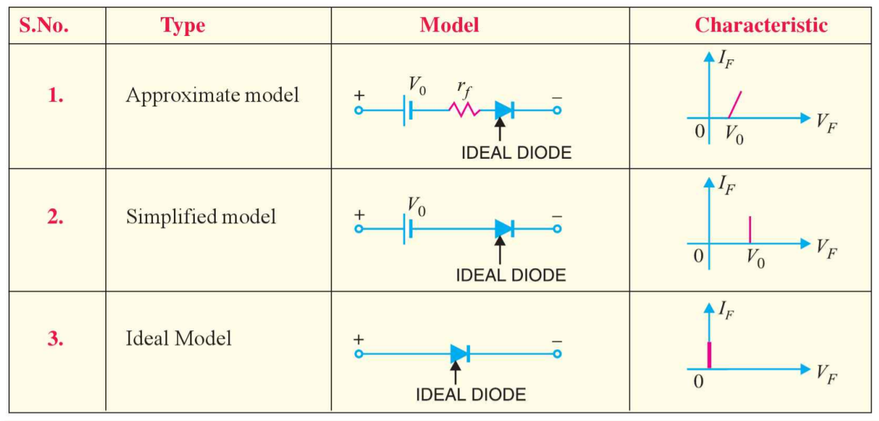
Summary of various model of diode:

Slide 19
Limitations in the Operating Conditions of pn Junction:
Maximum forward Current:
The highest forward current at which a pn diode can conduct without damage to the junction.
The rating of max. forward current is provided by the manufacturer.
If the forward current exceed beyond this rating, the pn-junction destroyed due to over heating.

Slide 20
Limitations in the operating conditions of pn Junction:
Peak inverse voltage (PIV):
The maximum reverse voltage applied to the pn-junction without damage the junction.
If the applied voltage to pn-junction is > PIV, the pn-junction destroyed due to excessive heat.

Slide 21
Limitations in the Operating Conditions of pn Junction:
Maximum power rating:
The maximum power that can dissipated at the junction of junction without damaging it.
The power dissipated at the junction is equal to the product of junction current and the voltage across the junction.

Slide 22
Limitations in the Operating Conditions of pn Junction:
Leakage current or reverse current:
The current that flows through a reverse biased diode.
This current is due to the minority carriers.
In normal operating voltages, this current is very small, almost <1 µm for silicon diodes and < 100 µm .

Slide 23
Crystal diode rectifiers:
Rectifiers are the circuit that convert a.c. signals into d.c.
The rectifier circuits are consist of crystal diodes, and mainly divided into two types:
Half-wave rectifier
Full-wave rectifier

Slide 24
Half-wave rectifier:
Half-wave rectifiers conduct current only during the positive half cycles of input a.c. supply.
The negative half-cycles of a.c. supply are suppressed, no current is conducted and no voltage appears across load.
Current always flow only in one direction through the load though after every half cycle.

Slide 25
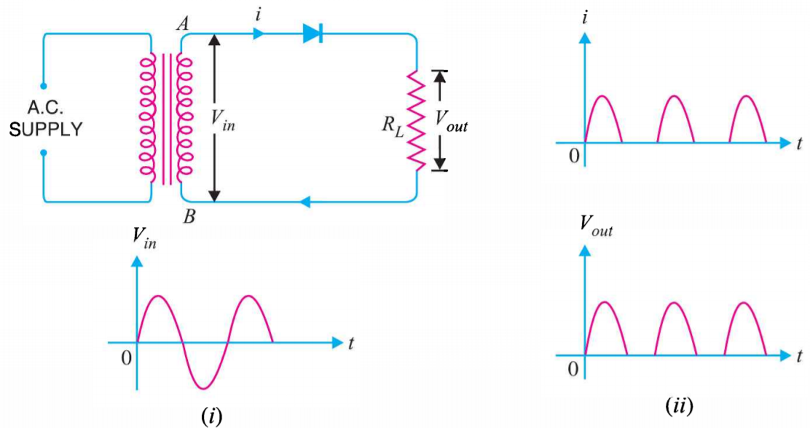
Half-wave rectifier: (cont.)
Circuit details and working mechanism:
The output across the load is pulsating d.c.
These pulsations in the output are further smoothened by using filters.

Slide 26
Half-wave rectifier: (cont.)
The use of transformer permits two advantage:
Allow to step-up or step-down the input voltage depend up on the requirements/situation.
It isolates the rectifier circuit from power line and reduces the risk of electric shock.

Slide 27
Half-wave rectifier: (cont.)
Disadvantages: The main advantages of half-wave rectifier are:
The a.c. supply delivers power only half the time, therefore the output is low.
Filtering circuits are required to produce steady state current.

Slide 28
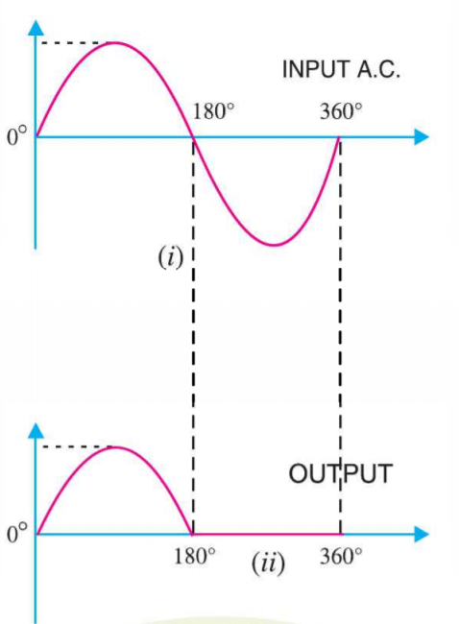

Output frequency of half-wave rectifier:
The output frequency of half-wave rectifier is equal to the input frequency (50 Hz).

Slide 29

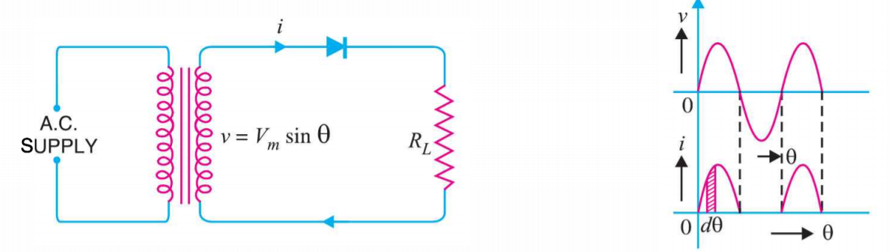
Efficiency of half-wave rectifier:
The ratio of d.c power output to the applied input a.c. power is known as rectifier efficiency i.e.

Slide 30
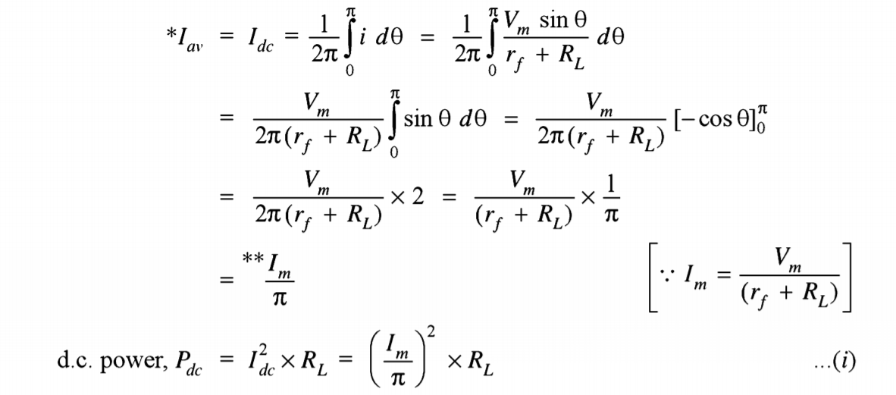
Efficiency of half-wave rectifier: (cont.)
d.c. power: The output current is pulsating direct current. Therefore, in order to find the d.c. power average current has to be found out.

Slide 31
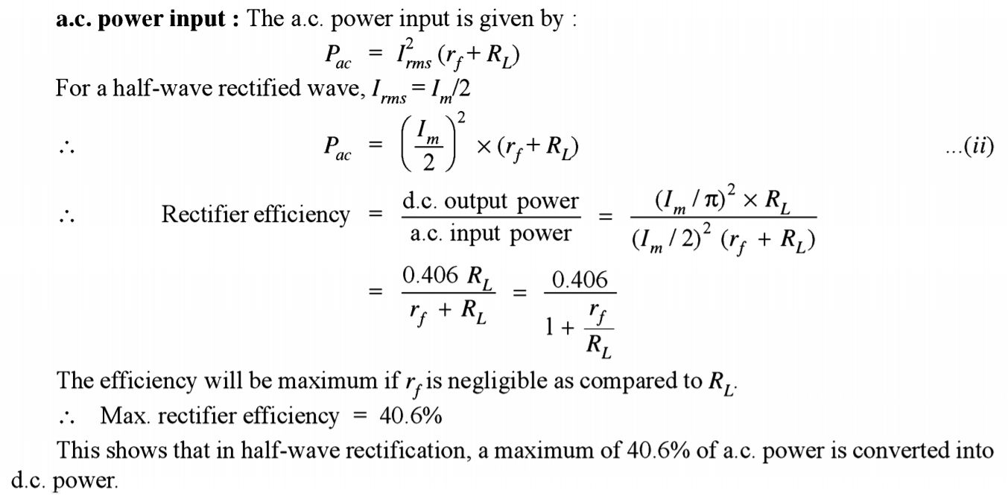
Efficiency of half-wave rectifier: (cont.)
a.c. power input: The a.c. power input is given by:

Slide 32
Applications:
Half Wave Rectifier used in low power simple battery charger circuit.
Half Wave Rectifiers are used in Pulse Generator Circuits.
Half Wave Rectifier is used in signal demodulation circuits.
In Soldering Iron circuit half wave rectifier used.
Half Wave Rectifier used in Amplitude Modulation (AM) Radio circuits as a Detector.

Slide 33

Any Questions ????????

